Slide 1
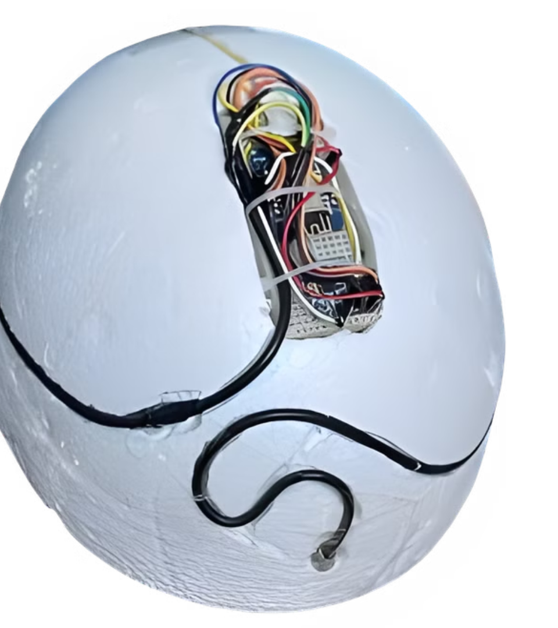

Smart Helmet with Temperature and Crash Detection
By:
Gobinda Lal Paul 14 Avik Dasgupta 19 Soham Dey 39 Shaileyee Purkayastha 41

Slide 2
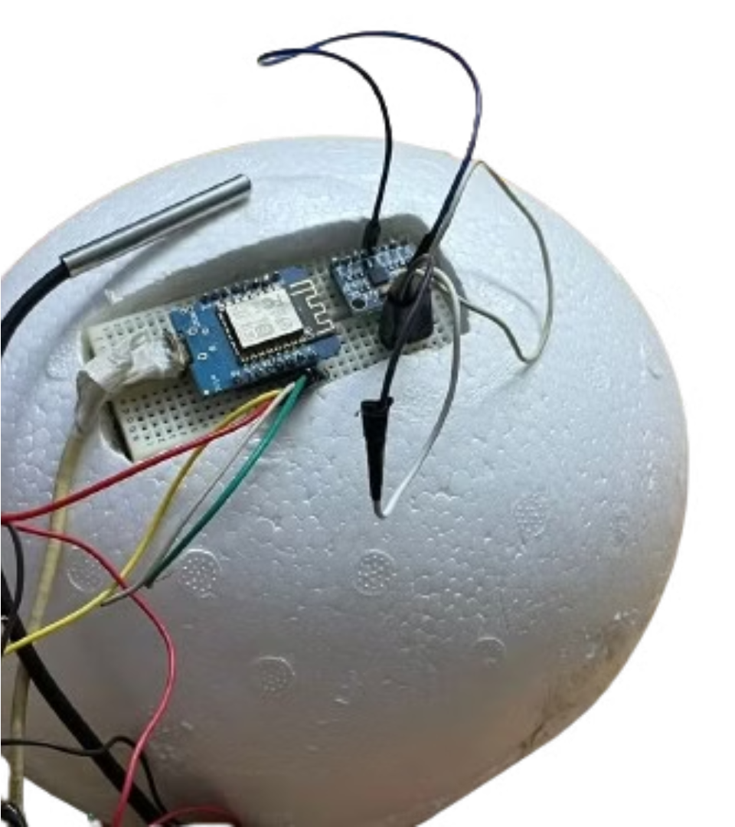
Problem Statement

Slide 3

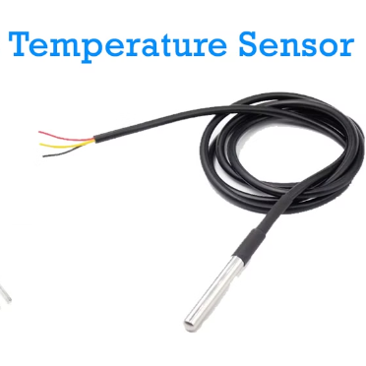
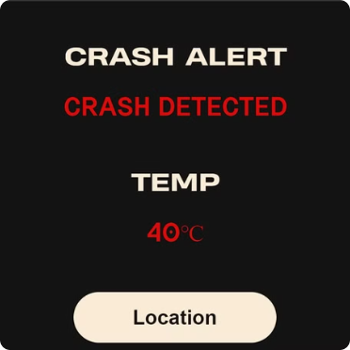

Objectives Of Our Smart Helmet
Detecting Heatstroke Possibility
Detection of Possible Crash/Fall
Location Detection and Emergency Alert System

Slide 4

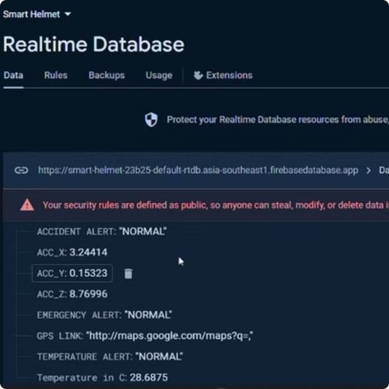
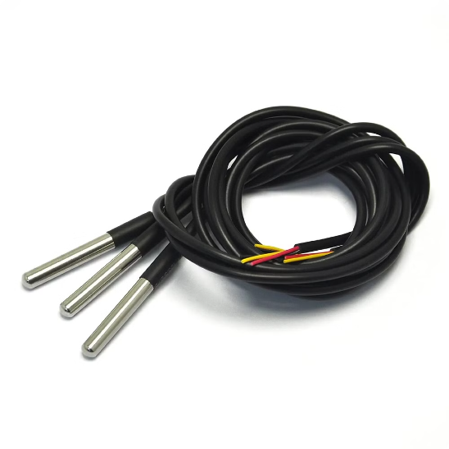
Defying Heat Stroke with Body Temperature Sensors
Heat stroke is a serious risk for construction workers, particularly in hot and humid environments. Our smart helmet is specially designed with body temperature sensors to monitor workers' vital signs, helping to identify and prevent heat stroke before it occurs.
Real Time Database
Temperature Sensor

Slide 5

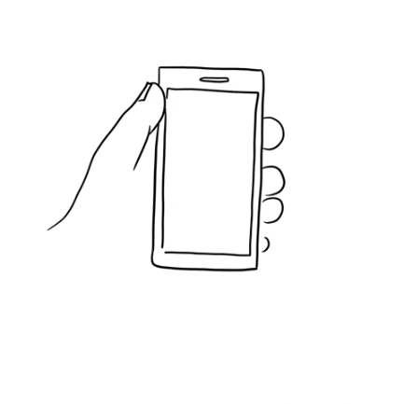

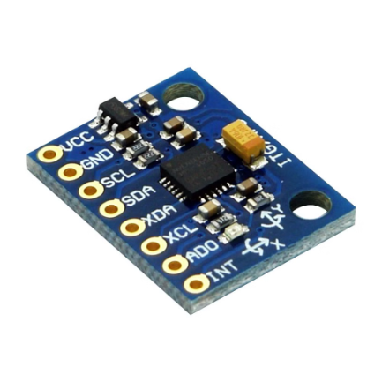
Protecting Workers with Crash Detection
Falls and impacts are a major source of accidents and injuries on construction sites and bike accidents. Our smart helmet's crash detection feature is an essential tool for mitigating the risk and severity of these incidents.
Instant Alarm
Location Tracking
Mpu 6050

Slide 6

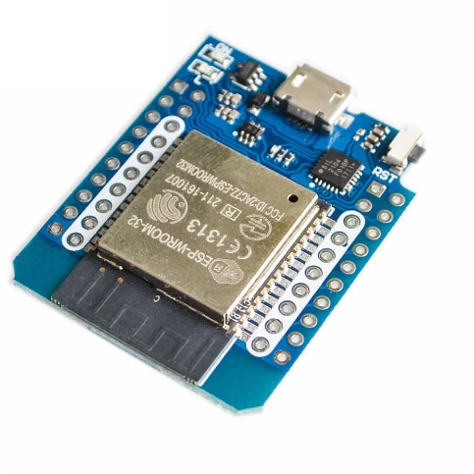

Microcontroller used in the Smart Helmet
Our smart helmet is powered by the cutting-edge technology of WEMOS D1 Mini(ESP8266) which uses C/C++ offering unmatched performance and reliability in worker safety solutions.
Wemos D1 Mini
C++(Used in Programming)

Slide 7

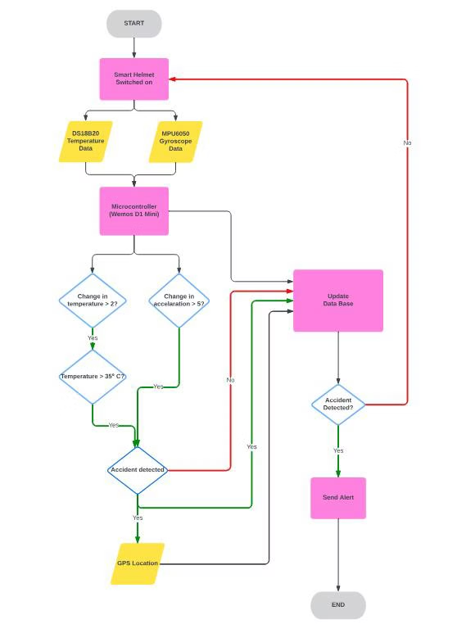
Implementation and Deployment
Our smart helmet is easy to implement and deploy on any construction site or on a biker's helmet, with plug-and-play compatibility and a straightforward user interface.

Slide 8



The Benefits of Using a Smart Helmet in a Construction site
Safety
Comfort
Smart Features

Slide 9

Future scope and directions
Augmented Reality
1
There is a possibility of integrating augmented reality technology in helmets.
2
Health Monitoring
The future of temperature sensor helmets is expected to include the capability of monitoring health metrics.
Eco-Friendly
3
The future of sensors will include making them environmentally responsible.
4
Implementing For Rider
With minimum changes our Project can be used by Riders.

Slide 10
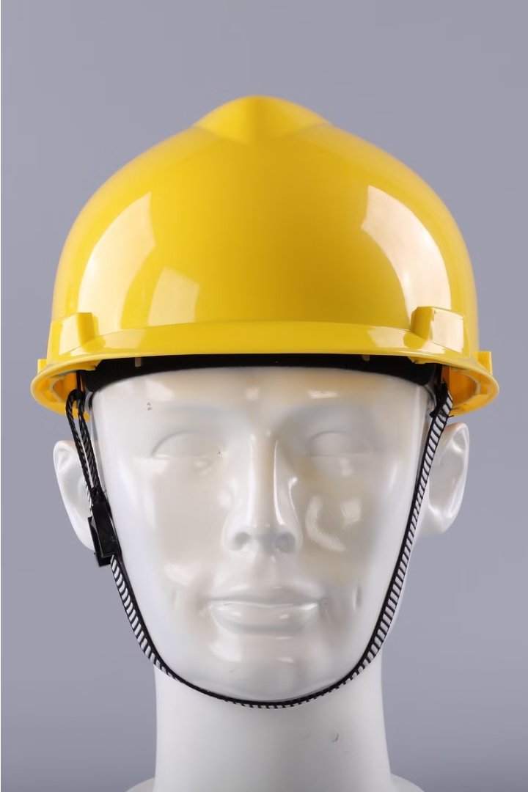
Conclusion
Worker safety should always be a top priority on construction sites and in roads, and our smart helmet is the most innovative and effective solution to that problem. By leveraging cutting-edge technology and an unwavering commitment to safety, we can help prevent accidents, injuries, and fatalities on the job, creating a safer and more productive workplace for everyone.

Slide 11
Acknowledgement
We would like to express our special thanks of gratitude to our mentor, Sujata Kundu ma'am and the entire faculty of IT Department who gave us the golden opportunity to work on this wonderful project on the topic "Smart Helmet with Temperature and Crash Detection". It also helped us in doing a lot of research and we came to know about many new things. Secondly, we would also like to thank our parents and friends who helped us a lot in finalising this project within the limited time frame.

Slide 12

References
Bergman, M., et al. (2017). Heat stress and heat-related illnesses. American Family Physician, 96(4), 256-262.
National Institute for Occupational Safety and Health (NIOSH). (2017). Falls in the Workplace. Retrieved from https://www.cdc.gov/niosh/topics/falls/default.html
Heat Stress – Heat Related Illness national Institute for Occupational Safety and Health https://rb.gy/hmter
Heatstroke: Symptoms & causes https://www.mayoclinic.org/diseases-conditions/heat-stroke/symptoms-causes/syc-20353581

